Slide 1
Artificial Intelligence
IUT AI Student Chapter
Mahya Jamshidian
Mohammad Amin Samadi
Maryam Meghdadi
Mohammad Sadegh Akhondzadeh

Slide 2
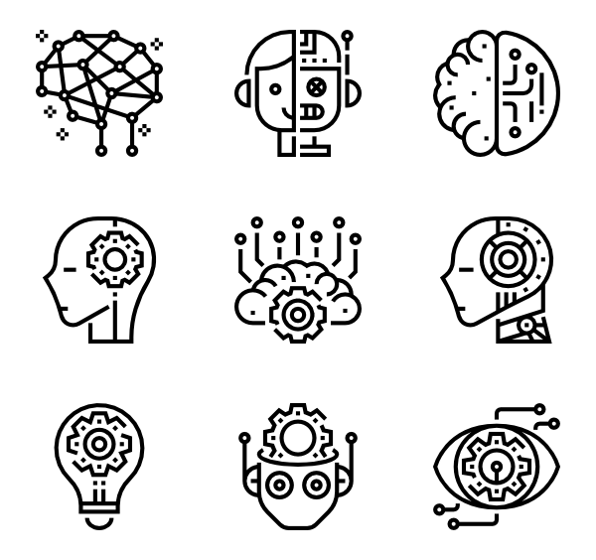
So, What is Artificial Intelligence?
The ability of a digital computer to perform tasks commonly associated with intelligent beings.

Slide 3
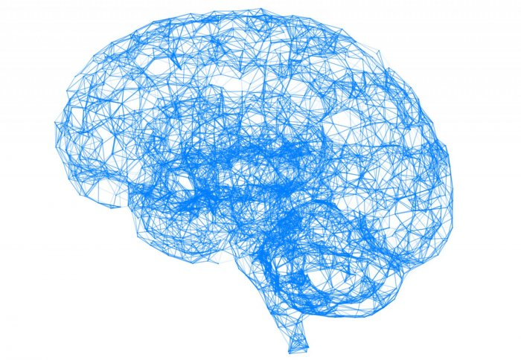
Ok, What is Intelligence ?
Learning
Reasoning
Problem solving
Perception
Using language.

Slide 4
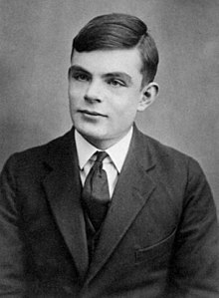
History of AI
The earliest substantial work in the field of artificial intelligence was done in the mid-20th century by the British logician and computer pioneer Alan Mathison Turing.

Slide 5
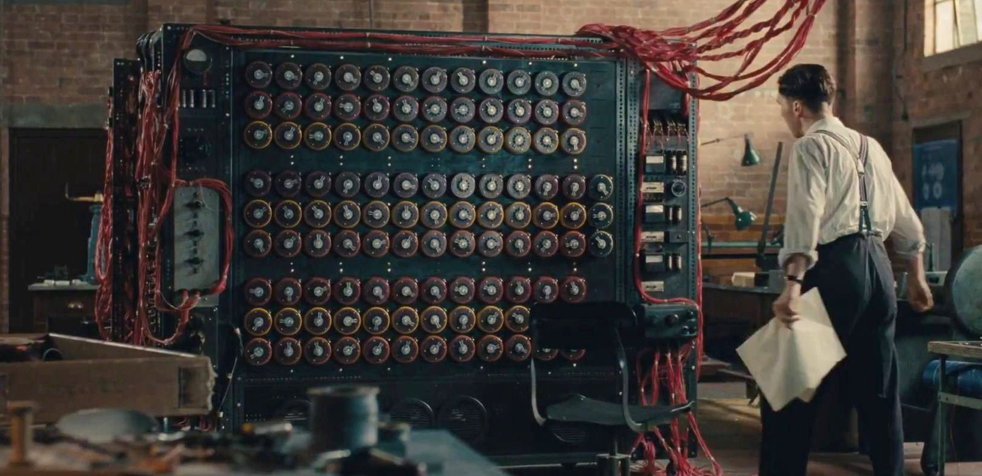
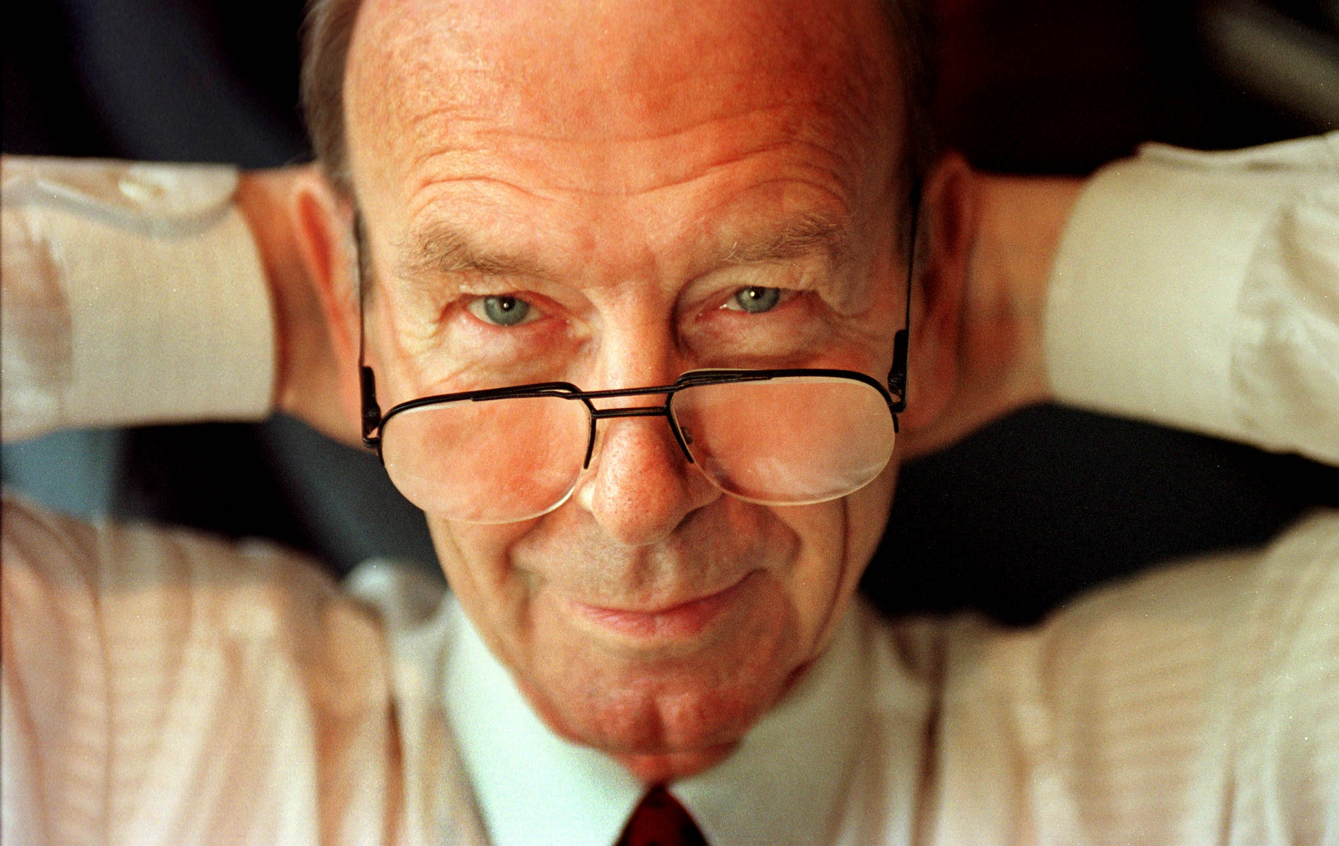
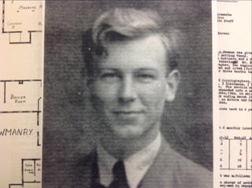
AI pioneers
Donald Michie (who later founded the Department of Machine Intelligence and Perception at the University of Edinburgh)

Slide 6
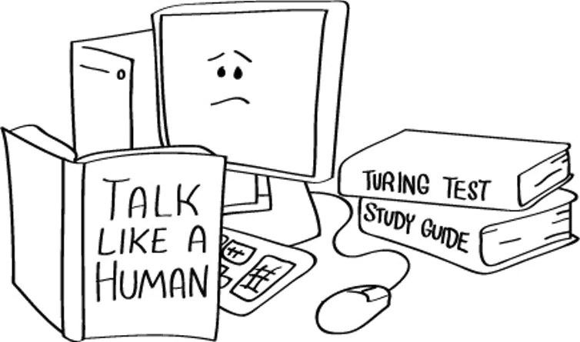
The Turing Test
This test involves three participants: a computer, a human interrogator, and a human foil.
How to check if our system is intelligent?

Slide 7
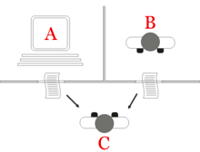
The Computer, The Interrogator and The Foil
keyboard and display screen.
The interrogator may ask any questions he or she likes
The computer is permitted to force a wrong identification.
The foil must help the interrogator to make a correct identification.

Slide 8
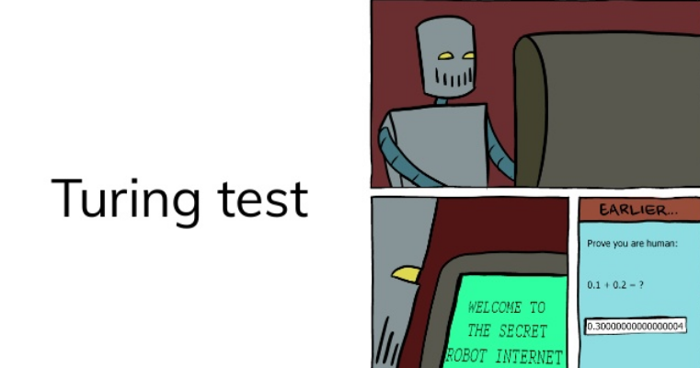

Slide 9
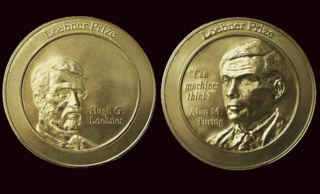

Slide 10
Artificial Intelligence -> Sub-Symbolic AI
-> Soft Computing -> Machine Learning

Slide 11
Machine Learning

Slide 12
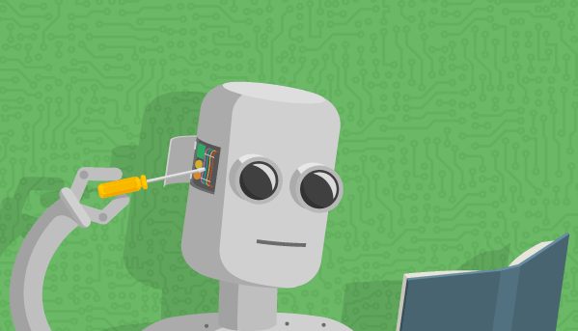

Slide 13
Machine learning is based on the idea that we can build machines to process data and learn on their own, without our constant supervision.

Slide 14
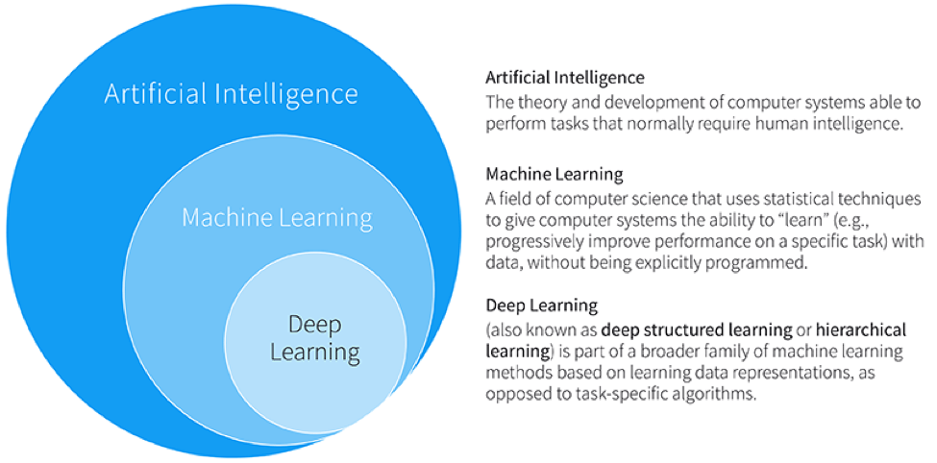

Slide 15
Machine Learning Applications

Slide 16
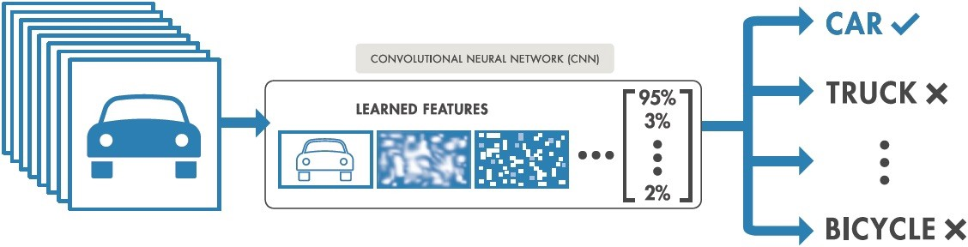
Convolutional Neural Networks (CNNs)
Image Recognition
Video Analysis

Slide 17
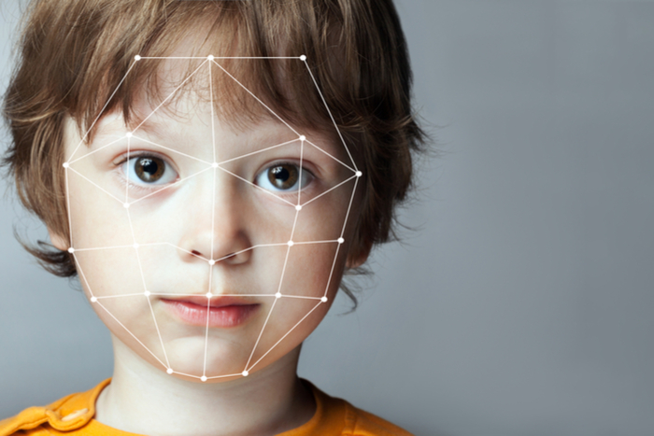
Image Recognition
Face Recognition
Face Emotion Recognition
Object Detection

Slide 18
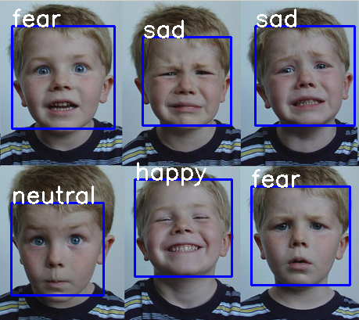
Image Recognition
Face Emotion Recognition

Slide 19

Image Recognition
Object Detection

Slide 20
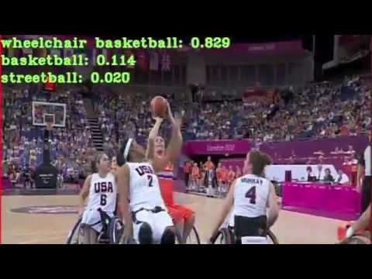
Video Analysis

Slide 21

ML in Bioinformatics
Genomics
Proteomics
Microarrays
Systems Biology

Slide 22
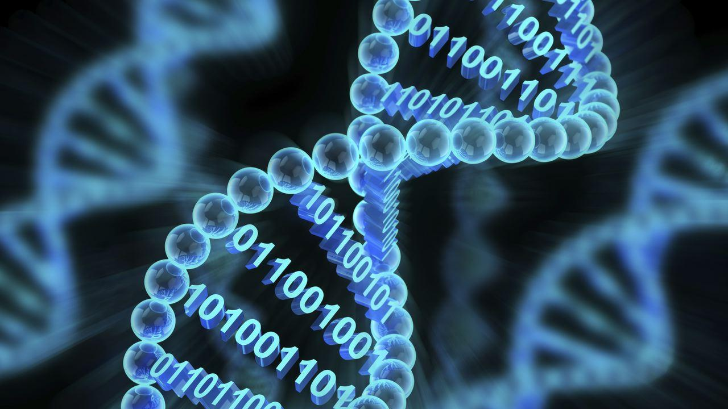
Genomics

Slide 23
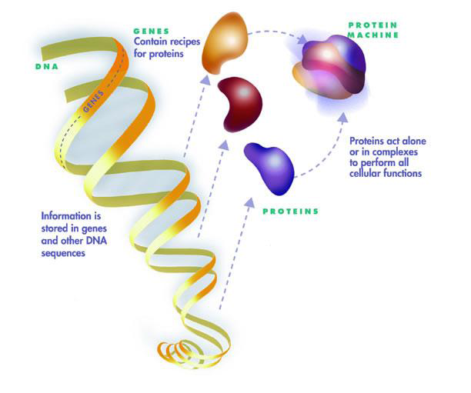
Proteomics

Slide 24
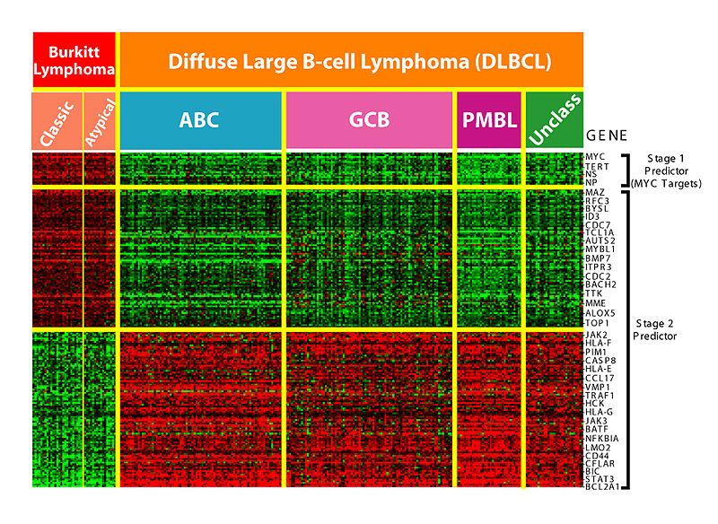
Microarrays

Slide 25
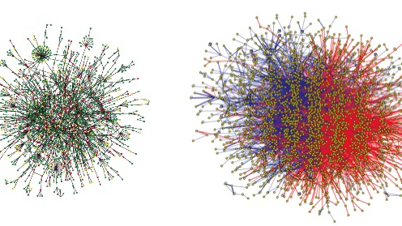
Systems Biology

Slide 26
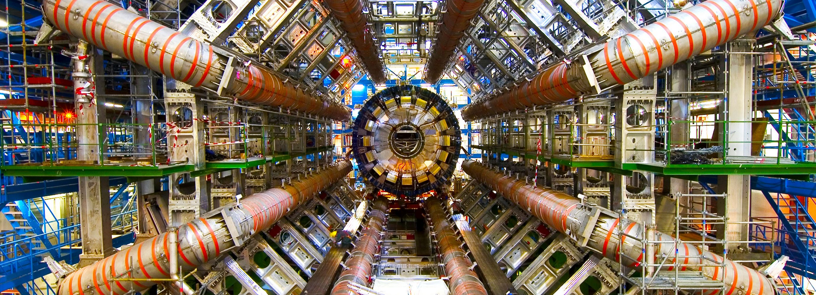
ML @ CERN

Slide 27
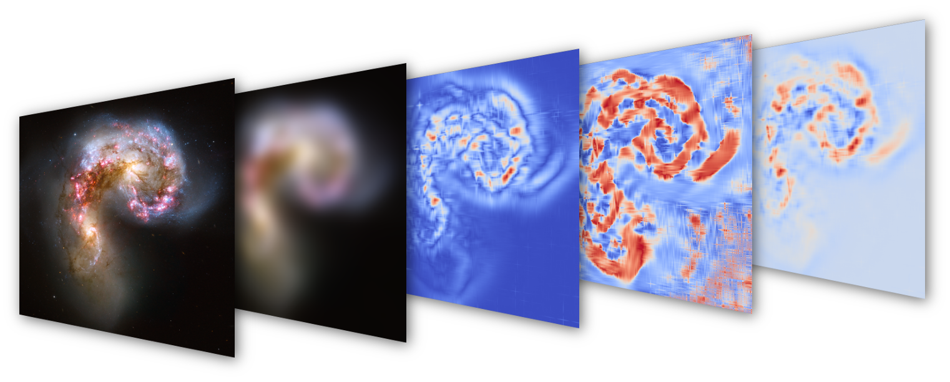
ML in Astrophysics & Cosmology

Slide 28

Natural Language Processing
Machine Translation
Named Entity Recognition
Natural Language Generation
Question Answering
Sentiment Analysis
Chatbots
Text Summarization

Slide 29

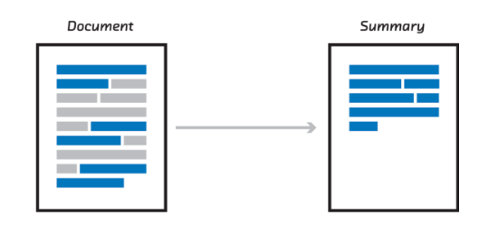
Text Summarization
Chatbots
Media Monitoring
Email Overload
Research
Meetings
Customer Service
Medical Guidance

Slide 30
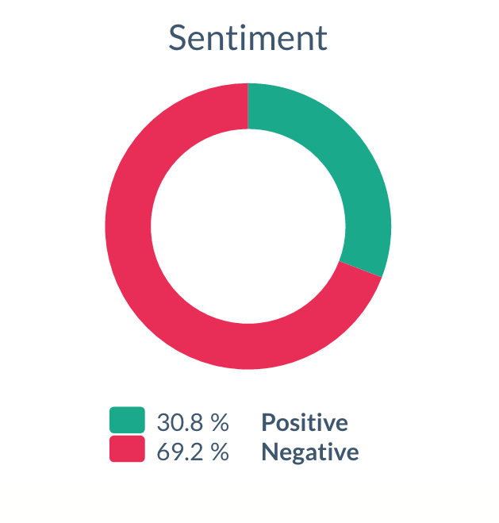
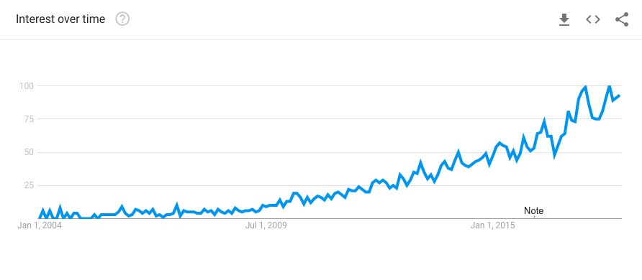
Sentiment Analysis
Resource Management
Reputation Management
Social Media

Slide 31
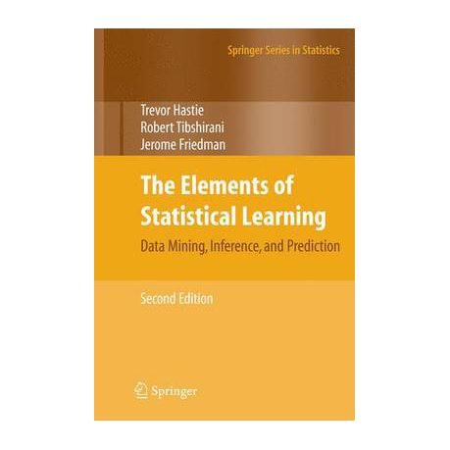
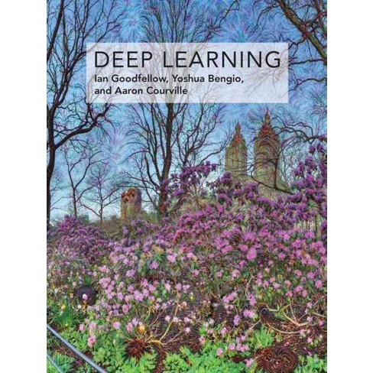
معرفی کتاب

Slide 32
معرفی دوره‌های آنلاین
Machine Learning by Andrew Ng Coursera
Deep Learning Specialization by Andrew Ng Coursera
Neural Networks and Deep Learning
Improving Deep Neural Networks: Hyperparameter tuning, Regularization and Optimization
Structuring Machine Learning Projects
Convolutional Neural Networks
Sequence Models

Slide 33
معرفی دوره ‌های آنلاین
Advanced Machine Learning Specialization by National Research University Higher School of Economics
Introduction to Deep Learning
Bayesian Methods for Machine Learning
Practical Reinforcement Learning
Deep Learning in Computer Vision
Natural Language Processing
Addressing Large Hadron Collider Challenges by Machine Learning

Slide 34
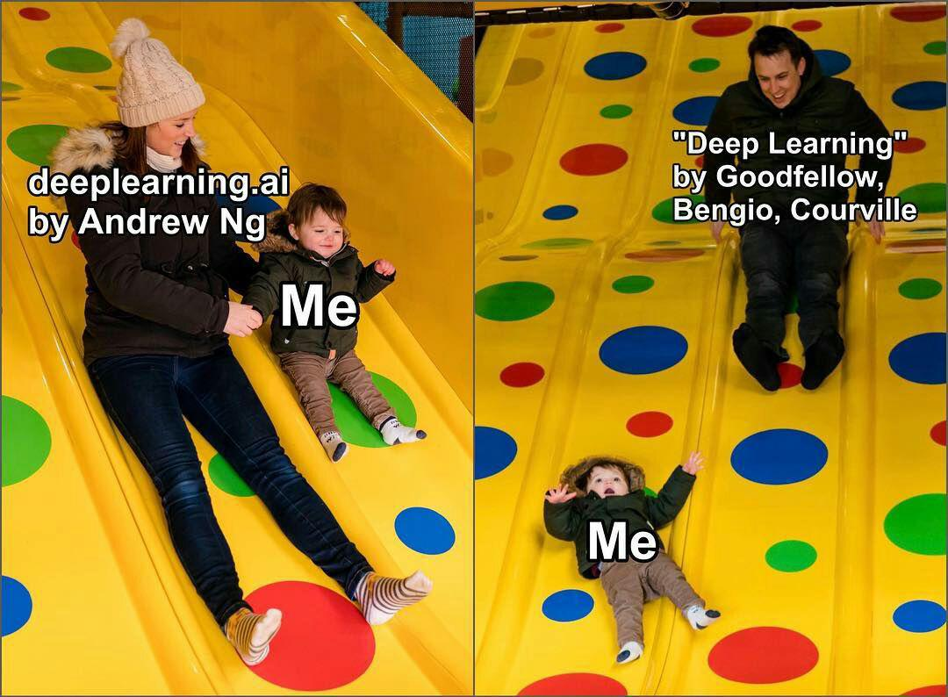

Slide 35
هسته هوش مصنوعی
فعالیت ها :
گروه مطالعاتی هفتگی
برگزاری دوره های یادگیری ماشین
همکاری با اساتید
شرکت در مسابقه‌هایی مثل kaggle و...

Slide 36

کانال تلگرام هسته ی هوش مصنوعی و انجمن علمی کامپیوتر
@IUTAICHAPTER
@IUTCESSA

